Slide 1
Randomized Algorithms CS648
Lecture 1

Slide 2
Deterministic Algorithm
Input
Output
Algorithm
The output as well as the running time are functions only of the input.
Notes:
The output as well as the running time are functions only of the input.

Slide 3


Slide 4
Example 1 : Approximate median

Slide 5

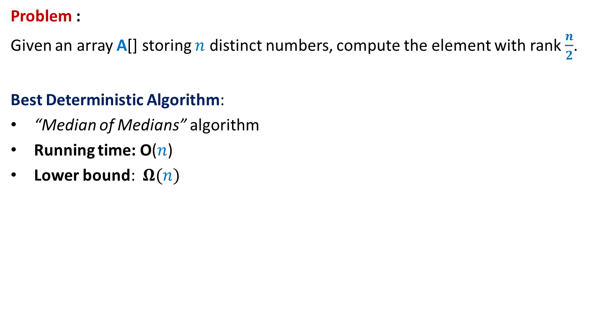
Approximate Median
Problem :
Given an array A[] storing $n$ distinct numbers, compute the element with rank $\frac{n}{2}$.
Best Deterministic Algorithm:
“Median of Medians” algorithm
Running time: O($n$)
Lower bound: $Ω(n)$
Reason: Every element must be read. Otherwise, …
A$[1..n]$
The unread element could be the median element.

Slide 6
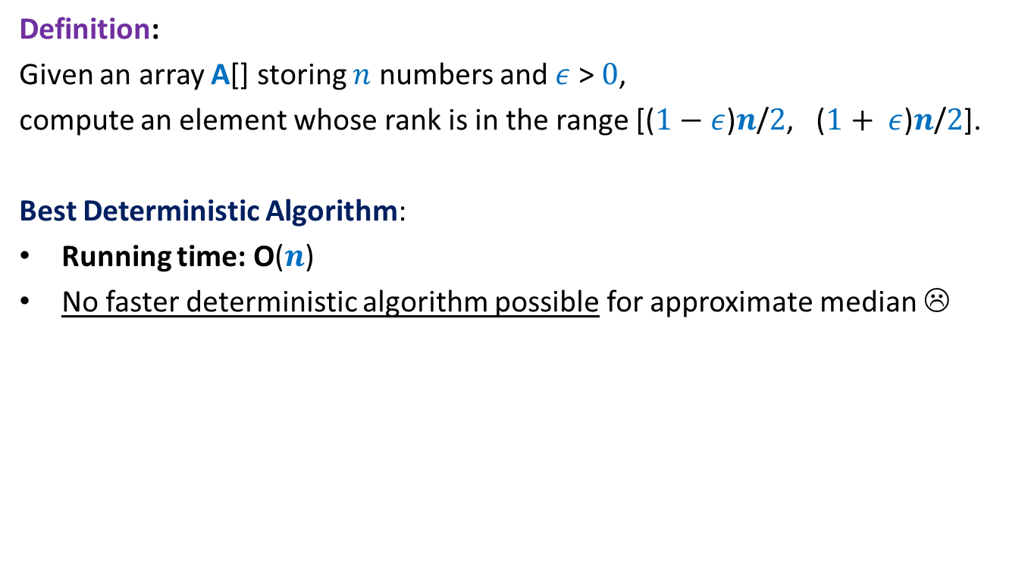

Approximate Median
Definition:
Given an array A[] storing $n$ numbers and $ε$ > $0$,
compute an element whose rank is in the range [($1−$ $ε$)$n$/$2$, ($1+ ε$)$n$/$2$].
Best Deterministic Algorithm:
Running time: O($n$)
No faster deterministic algorithm possible for approximate median ☹
$ε$ $=\frac{1}{2}$
Reason: At least $n/2$elements must be read. Otherwise, …
A$[1..n]$
½ - Approximate median elements could all be unread elements

Slide 7

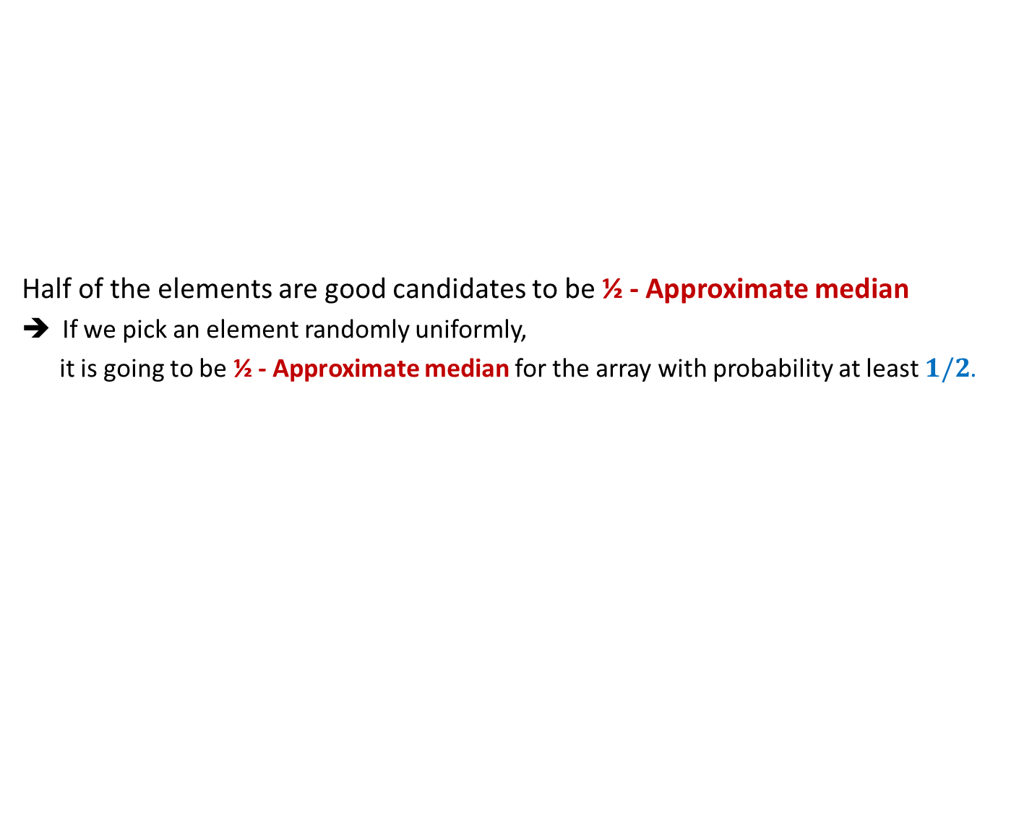
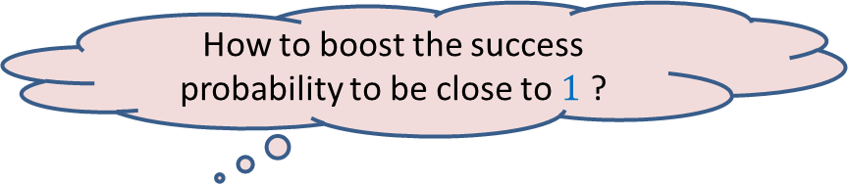

½ - Approximate median
Half of the elements are good candidates to be ½ - Approximate median
If we pick an element randomly uniformly,
it is going to be ½ - Approximate median for the array with probability at least $1/2$.
$$n/4$$
Elements of A arranged in Increasing order of values
$$3n/4$$
A$[1..n]$
How to boost the success probability to be close to $1$ ?
Pick a few elements and return their median. ☺

Slide 8
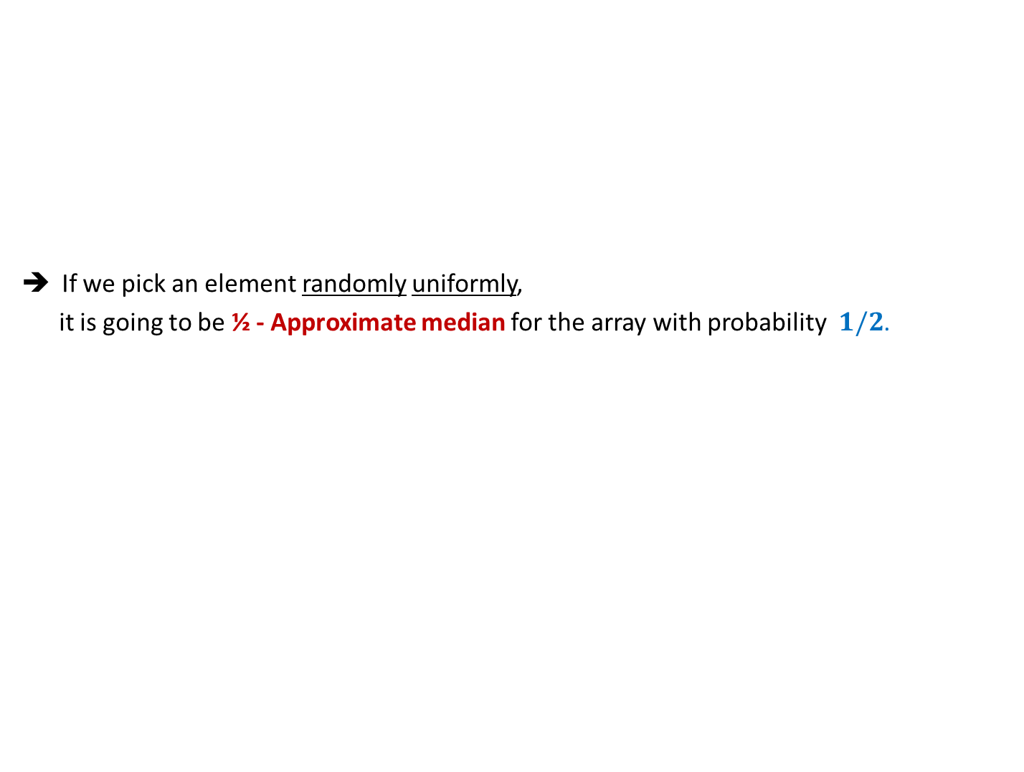
½ - Approximate median
If we pick an element randomly uniformly,
it is going to be ½ - Approximate median for the array with probability $1/2$.
$$n/4$$
Elements of A arranged in Increasing order of values
$$3n/4$$
A$[1..n]$
How to boost the success probability to be close to $1$ ?
Pick a few elements and return their median. ☺

Slide 9

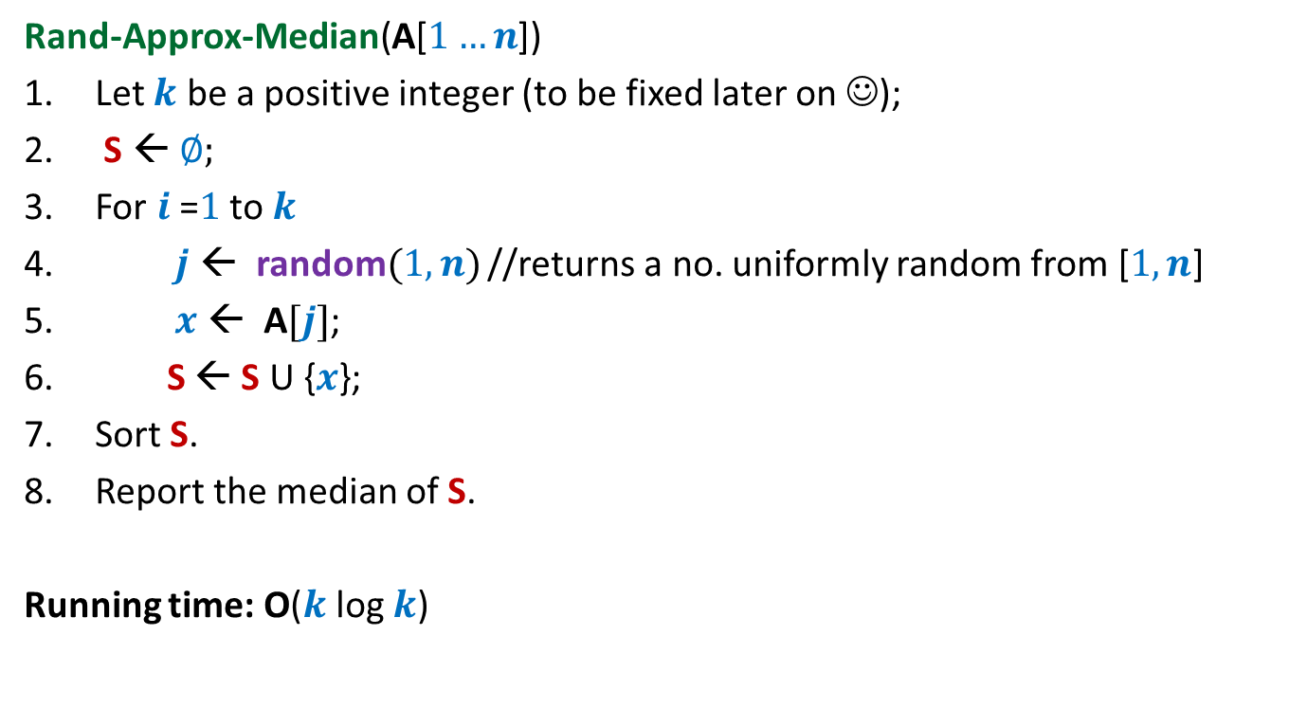
½ - Approximate median A Randomized Algorithm
Rand-Approx-Median(A[$1…n$])
Let $k$ be a positive integer (to be fixed later on ☺);
S ← ∅;
For $i$=$1$ to $k$
$j$ ← random$(1,n)$ //returns a no. uniformly random from [$1,n$]
$x$ ← A$[j]$;
S ← S U {$x$};
Sort S.
Report the median of S.
Running time: O($k$ log $k$)
in Output
On a few occasions

Slide 10
Example 2 : randomized Quick Sort

Slide 11
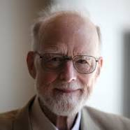
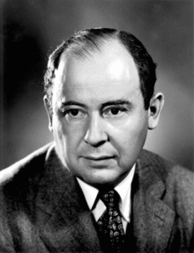
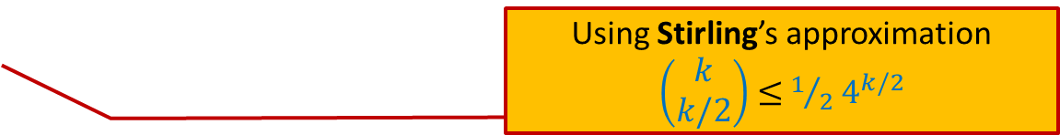
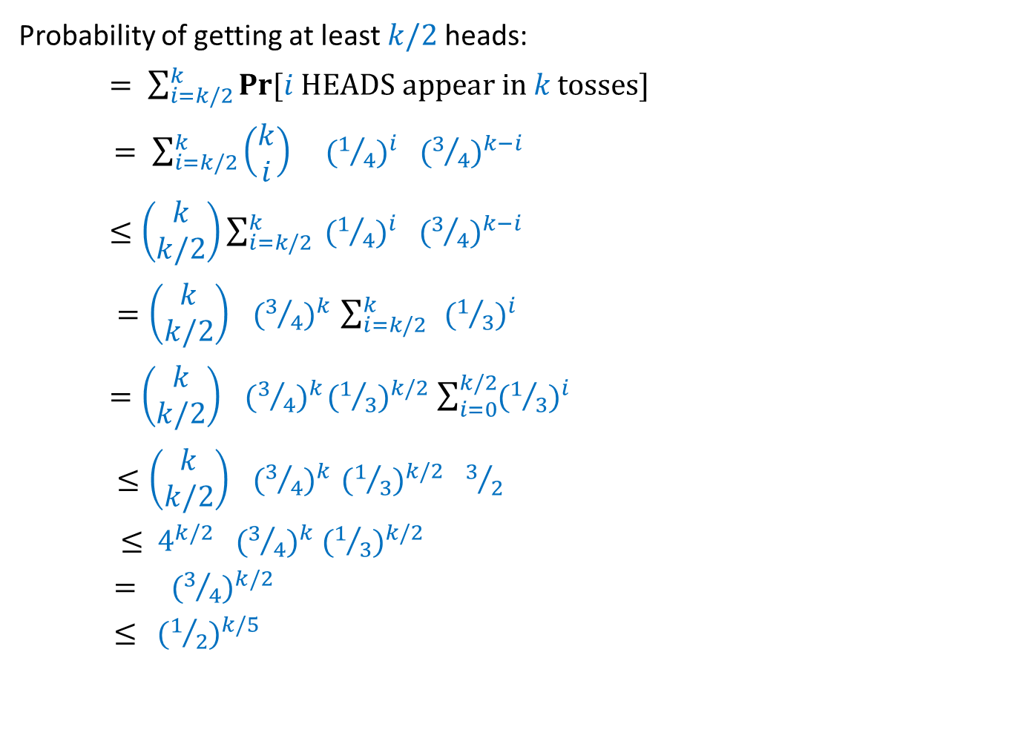


C. A. R. Hoare
John von Neumann
Quick Sort, 1960
Merge Sort, 1945
 | Merge Sort | Quick Sort
Average case comparisons
Worst case comparisons
$$n\log_{2}{n}$$
1.39 $n\log_{2}{n}$
$$n\log_{2}{n}$$
$$n(n−1)$$

Slide 12
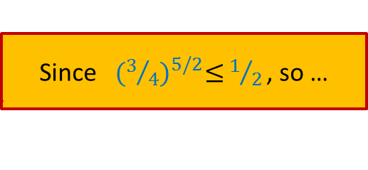

QuickSort($S$) When the input $S$is stored in an array $A$
QuickSort($A$,$l$, $r$)
{ If ($l$ < $r$)
$x$← $A$[$l$];
$i$← Partition($A$,$l$,$r$,x);
QuickSort($A$,$l$, $i−1$);
QuickSort($A$,$i+1$, $r$)
}

Slide 13
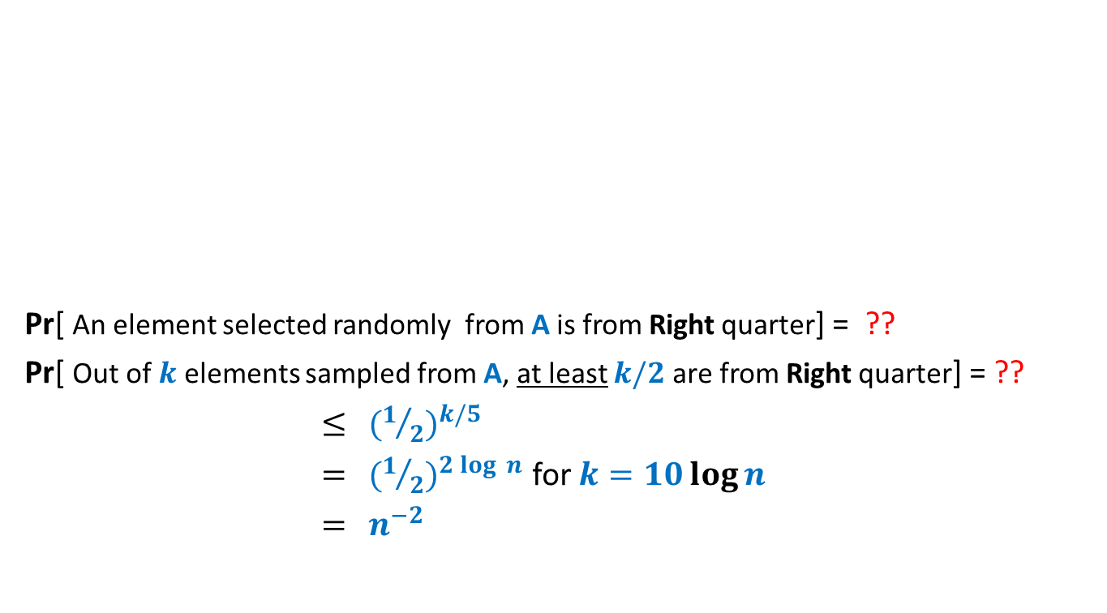

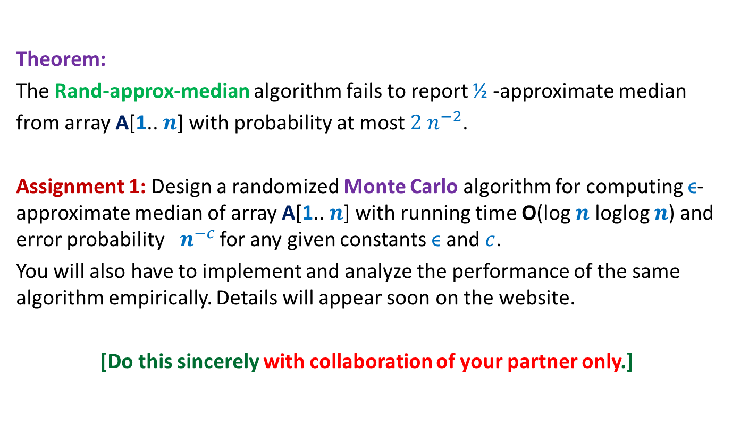
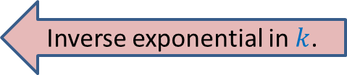
Quick sort versus Merge Sort
In Practice
Input: a random permutation of $n$ numbers.
No. of repetitions: $1000$
Reasons:
Overhead of copying in Merge Sort
Cache misses
This table was reported as a part of an assignment by a student in the Data Structures course (taught in 2014).
No. of times Merge sort outperformed Quick sort
$$n=100$$
$$n=1000$$
$$n≥10000$$
$$0.1\%$$
$$0.02\%$$
$$0\%$$

Slide 14

A serious problem with QuickSort
QuickSort($A$,$l$, $r$)
{ If ($l$ < $r$)
$x$← $A$[$l$];
$i$← Partition($A$,$l$,$r$,x);
QuickSort($A$,$l$, $i−1$);
QuickSort($A$,$i+1$, $r$)
}
Distribution sensitive:
Time taken depends upon the initial permutation of $A$.
an element selected randomly uniformly from $A$[$l$..$r$];
Can we make QuickSort distribution insensitive ?

Slide 15
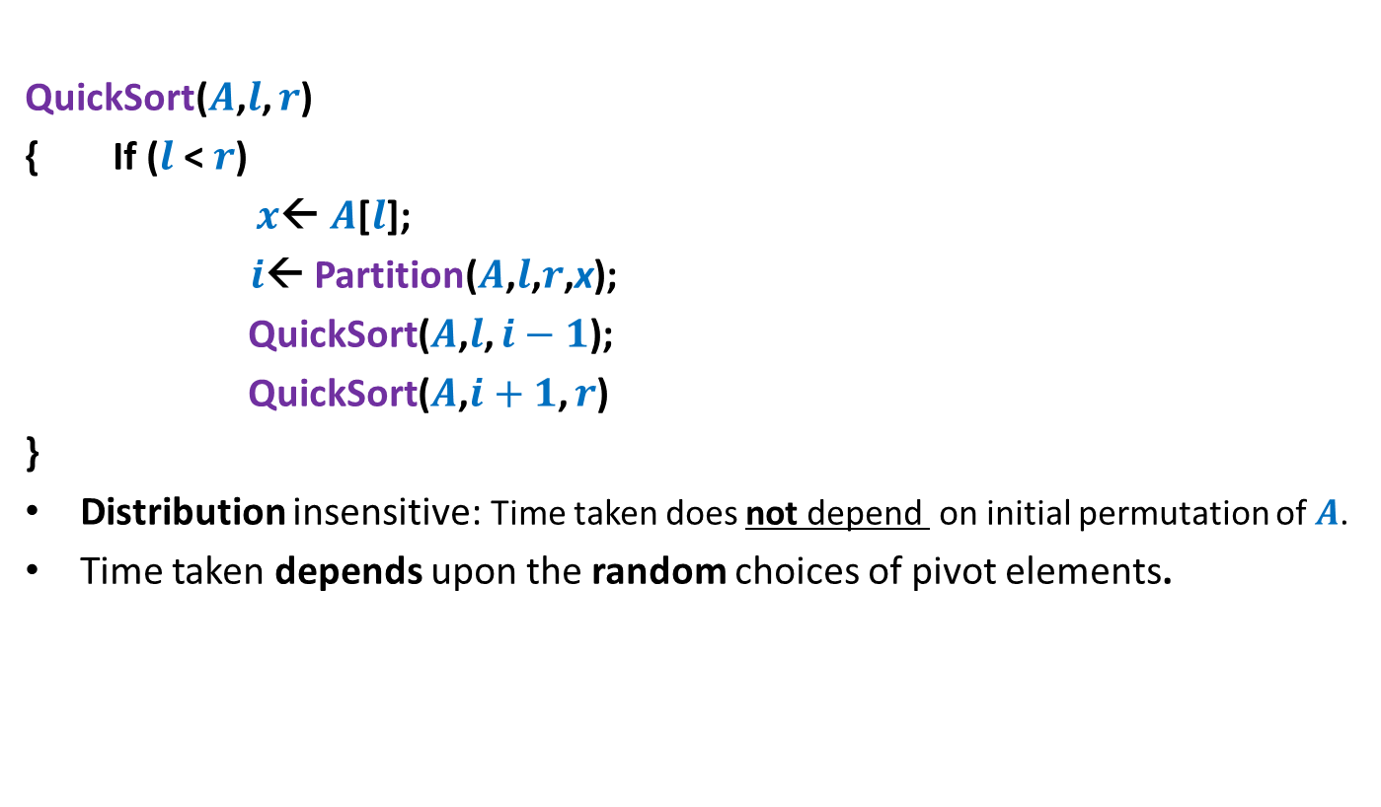

Randomized QuickSort($S$) When the input $S$is stored in an array $A$
QuickSort($A$,$l$, $r$)
{ If ($l$ < $r$)
$x$← $A$[$l$];
$i$← Partition($A$,$l$,$r$,x);
QuickSort($A$,$l$, $i−1$);
QuickSort($A$,$i+1$, $r$)
}
Distribution insensitive: Time taken does not depend on initial permutation of $A$.
Time taken depends upon the random choices of pivot elements.
an element selected randomly uniformly from $A$[$l$..$r$];

Slide 16
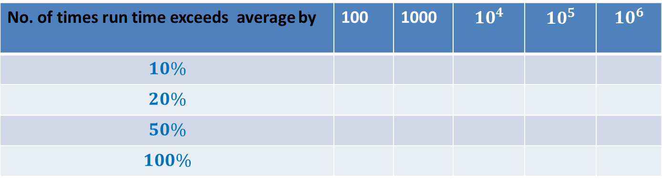
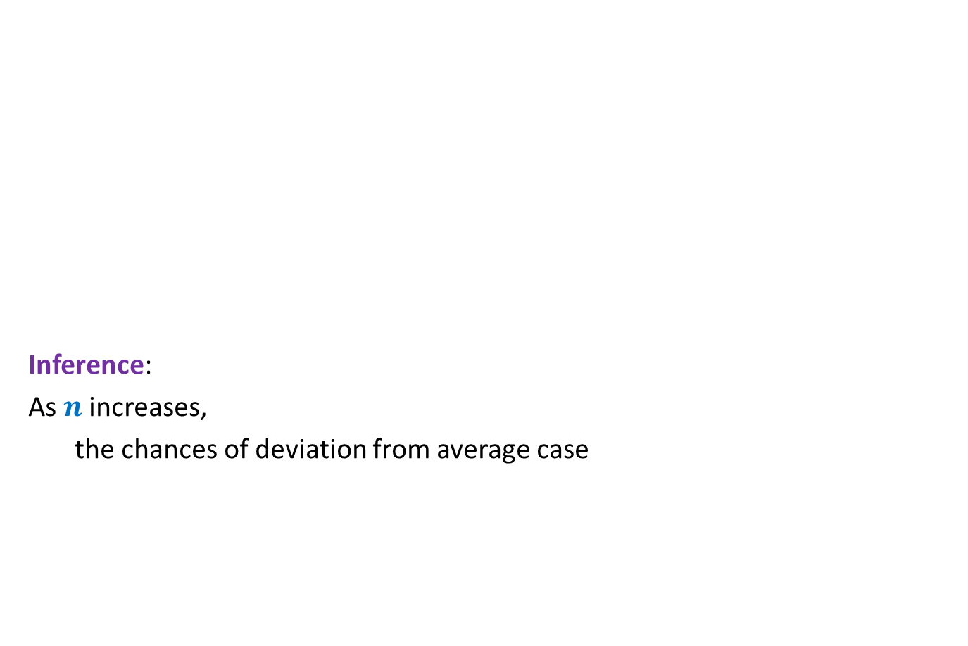

What makes Randomized Quick sort popular ?
No. of repetitions = $1000$
Inference:
As $n$ increases,
the chances of deviation from average case
This table was reported as a part of an assignment by a student in the Data Structures course (taught in 2014).
No. of times run time exceeds average by | 100 | 1000 | $$10^{4}$$ | $$10^{5}$$ | $$10^{6}$$
$$10\%$$
$$20\%$$
$$50\%$$
$$100\%$$
190
28
2
0
49
17
1
0
22
12
1
0
10
3
0
0
3
0
0
0
The reliability of quick sort

Slide 17



The analysis of Randomized Quick sort
Theorem [Colin McDiarmid, 1991]:
Prob. the run time of Randomized Quick sort exceeds average by $x\%$ =
➔
Prob. run time of Randomized quick sort is double the average for $n=10^{6}$ is ?
$$n^{− \frac{x}{100} ln ln n}$$
$$10^{−15}$$

Slide 18
Deterministic Algorithm
Input
Output
Algorithm
The output as well as the running time are functions only of the input.
Notes:
The output as well as the running time are functions only of the input.

Slide 19

Deterministic Algorithm
Randomized
Random bits
Input
Output
Algorithm
The output as well as the running time are functions of the input and random bits chosen.
or
Excess running time
on a few occasions
in Output
On a few occasions
Notes:
The output or the running time are functions of the input and random bits chosen .

Slide 20
Still why to study Randomized Algorithms ?
Efficiency
Simplicity
→……….
Deterministic algo.

Slide 21
Types of Randomized Algorithms
Randomized Las Vegas Algorithms:
Output is always correct
Running time is a random variable
Example: Randomized Quick Sort
Randomized Monte Carlo Algorithms:
Output may be incorrect with some probability
Running time is deterministic.
Example: Randomized algorithm for approximate median

Slide 22
½ - Approximate median A Randomized Algorithm
Rand-Approx-Median(A[$1…n$])
Let $k$ be a positive integer (to be fixed later on ☺);
S ← ∅;
For $i$=$1$ to $k$
$j$ ← random$(1,n)$ //returns a no. uniformly random from [$1,n$]
$x$ ← A$[j]$;
S ← S U {$x$};
Sort S.
Report the median of S.
Running time: O($k$ log $k$)

Slide 23


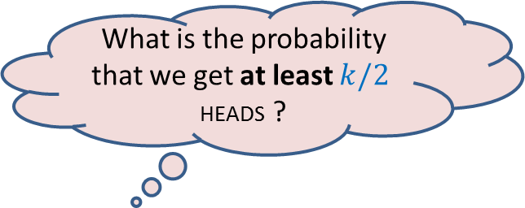
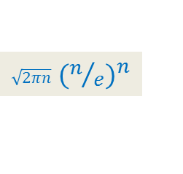
A simple probability exercise
P[HEADS] = ¼
P[TAILS] = ¾
The coin is tossed $k$ times.
[Stirling’s approximation for Factorial: $n! ≈$ ? ]
What is the probability that we get at least $k/2$ HEADS ?
$\sqrt{2πn}$ ${(n/e)}^{n}$

Slide 24
Probability of getting “at least $k/2$HEADS in $k$tosses”
Probability of getting at least $k/2$heads:
$= \sum_{i=k/2}^{k}{Pr\text{[}i \text{HEADS} \text{appear} \text{in} k \text{tosses}\text{]}}$
$= \sum_{i=k/2}^{k}{\left(\begin{matrix}k \\ i\end{matrix}\right) }{ (1/4)}^{i}{ (3/4)}^{k−i}$
$≤\left(\begin{matrix}k \\ k/2\end{matrix}\right)\sum_{i=k/2}^{k}{ {(1/4)}^{i}{ (3/4)}^{k−i}}$
$=\left(\begin{matrix}k \\ k/2\end{matrix}\right){ (3/4)}^{k} \sum_{i=k/2}^{k}{ }{(1/3)}^{i}$
$=\left(\begin{matrix}k \\ k/2\end{matrix}\right){ (3/4)}^{k}{(1/3)}^{k/2} \sum_{i=0}^{k/2}{{(1/3)}^{i}}$
$≤\left(\begin{matrix}k \\ k/2\end{matrix}\right){ (3/4)}^{k} {(1/3)}^{k/2}{ 3}/2$
$≤$ $4^{k/2}{ (3/4)}^{k} {(1/3)}^{k/2}$
$=$ ${ (3/4)}^{k/2}$
$≤{ (1/2)}^{k/5}$
Using Stirling’s approximation
$\left(\begin{matrix}k \\ k/2\end{matrix}\right)$ $≤$ $1/2$ $4^{k/2}$
Inverse exponential in $k$.
Since${ (3/4)}^{5/2}≤$ $1/{2 }$, so …

Slide 25
Analyzing the error probability of Rand-approx-median
$$n/4$$
Elements of A arranged in Increasing order of values
$$3n/4$$
Left Quarter
Right Quarter
Lets us consider an instance of sample set S

Slide 26
Analyzing the error probability of Rand-approx-median
$$n/4$$
Elements of A arranged in Increasing order of values
$$3n/4$$
Median of S
Left Quarter
Right Quarter
Answer is correct
When does Rand-approx-median make an error ?

Slide 27
Analyzing the error probability of Rand-approx-median
$$n/4$$
Elements of A arranged in Increasing order of values
$$3n/4$$
Median of S
Left Quarter
Right Quarter
Answer is incorrect
What might have gone wrong with S ?

Slide 28
Analyzing the error probability of Rand-approx-median
Observation: Rand-approx-median makes an error only if
……………………………………………?.......................................
$$n/4$$
Elements of A arranged in Increasing order of values
$$3n/4$$
Median of S
Left Quarter
Right Quarter
at least $k/2$ elements got sampled from the Right Quarter
(or Left Quarter).

Slide 29
Analyzing the error probability of Rand-approx-median
Pr[ An element selected randomly from A is from Right quarter] = ??
Pr[ Out of $k$ elements sampled from A, at least $k/2$ are from Right quarter] = ??
$≤{ (1/2)}^{k/5}$
$={ (1/2)}^{2 log{ n}}$ for $k=10\log{n}$
$={ n}^{−2}$
$$n/4$$
Elements of A arranged in Increasing order of values
$$3n/4$$
Left Quarter
Right Quarter
¼
Exactly the same as the coin tossing exercise we did !

Slide 30

Theorem:
The Rand-approx-median algorithm fails to report ½ -approximate median
from array A[1.. $n$] with probability at most${ 2 n}^{−2}$.

Slide 31






What makes Randomized Algorithms so popular ?
[A study by Microsoft in $2008$]
Title: Cycles, Cells and Platters: An Empirical Analysis of Hardware Failures on a Million Consumer PCs
Authors: Edmund B. Nightingale, John R. Douceur, Vince Orgovan
Available at : research.microsoft.com/pubs/144888/eurosys84-nightingale.pdf
Event | Probability
The desktop of RM301 crashes during this lecture
$>$ $10^{−7}$
$$n≥10^{6}$$
RandQsort takes time at least double the average
$$<10^{−15}$$
$2$-ApproxMedian returns wrong output
$$<10^{−12}$$
Simplicity

Slide 32
MotivatiNG Examples for randomized Algorithms

Slide 33
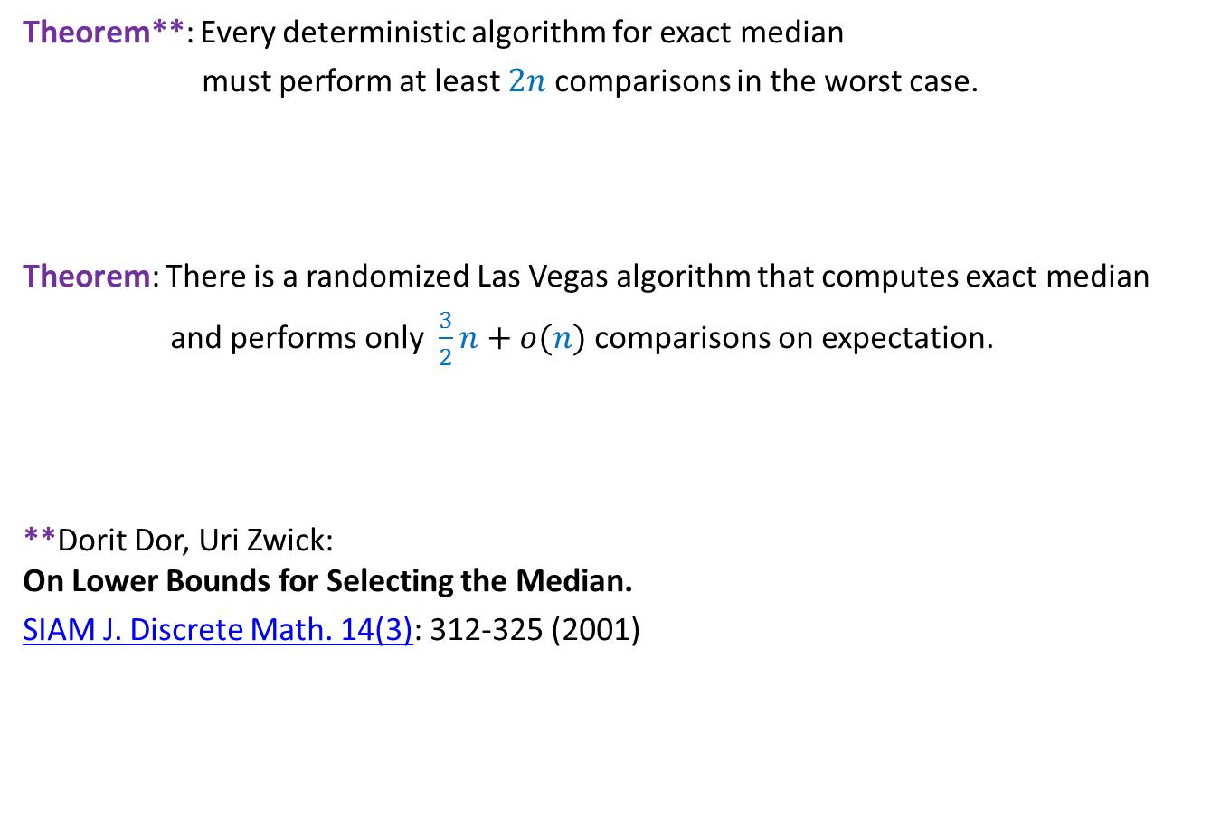
Exact Median
Theorem**: Every deterministic algorithm for exact median
must perform at least $2n$ comparisons in the worst case.
Theorem: There is a randomized Las Vegas algorithm that computes exact median
and performs only $\frac{3}{2}n+o(n)$ comparisons on expectation.
**Dorit Dor, Uri Zwick: On Lower Bounds for Selecting the Median.
SIAM J. Discrete Math. 14(3): 312-325 (2001)
Project 1

Slide 34

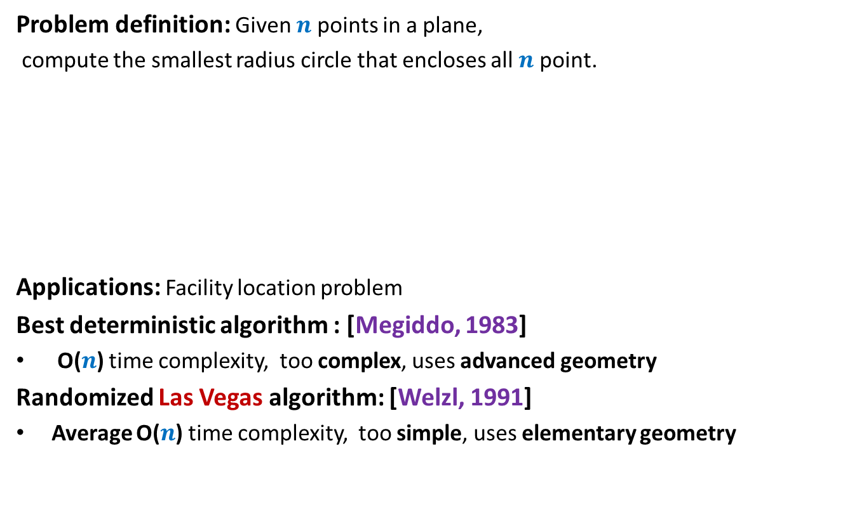
Example 3: Smallest Enclosing circle
Problem definition: Given $n$ points in a plane,
compute the smallest radius circle that encloses all $n$ point.
Applications: Facility location problem
Best deterministic algorithm : [Megiddo, 1983]
O($n$) time complexity, too complex, uses advanced geometry
Randomized Las Vegas algorithm: [Welzl, 1991]
Average O($n$) time complexity, too simple, uses elementary geometry
Simple exercise : O($n^{4}$)
Project 2

Slide 35
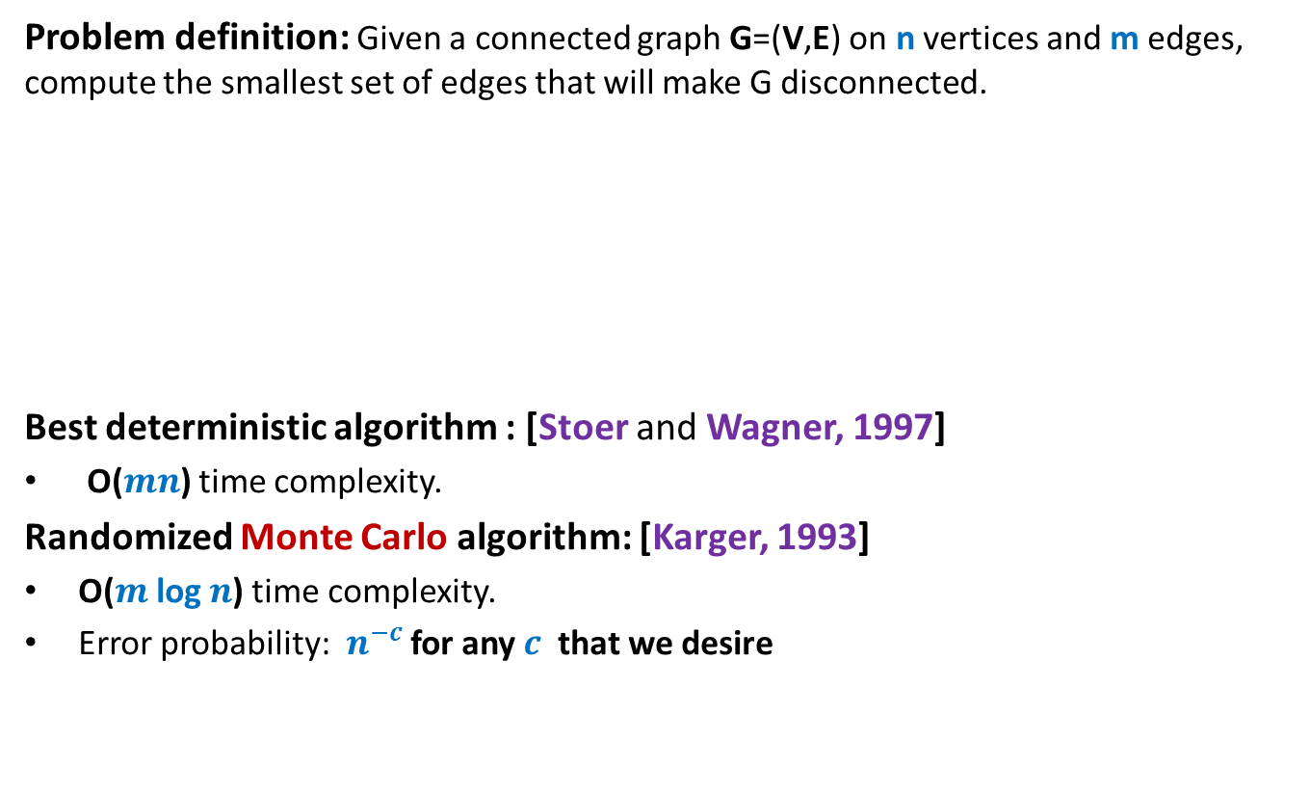
Example 4: minimum Cut
Problem definition: Given a connected graph G=(V,E) on n vertices and m edges, compute the smallest set of edges that will make G disconnected.
Best deterministic algorithm : [Stoer and Wagner, 1997]
O($mn$) time complexity.
Randomized Monte Carlo algorithm: [Karger, 1993]
O($m$ log $n$) time complexity.
Error probability: $n^{−c}$ for any $c$ that we desire

Slide 36

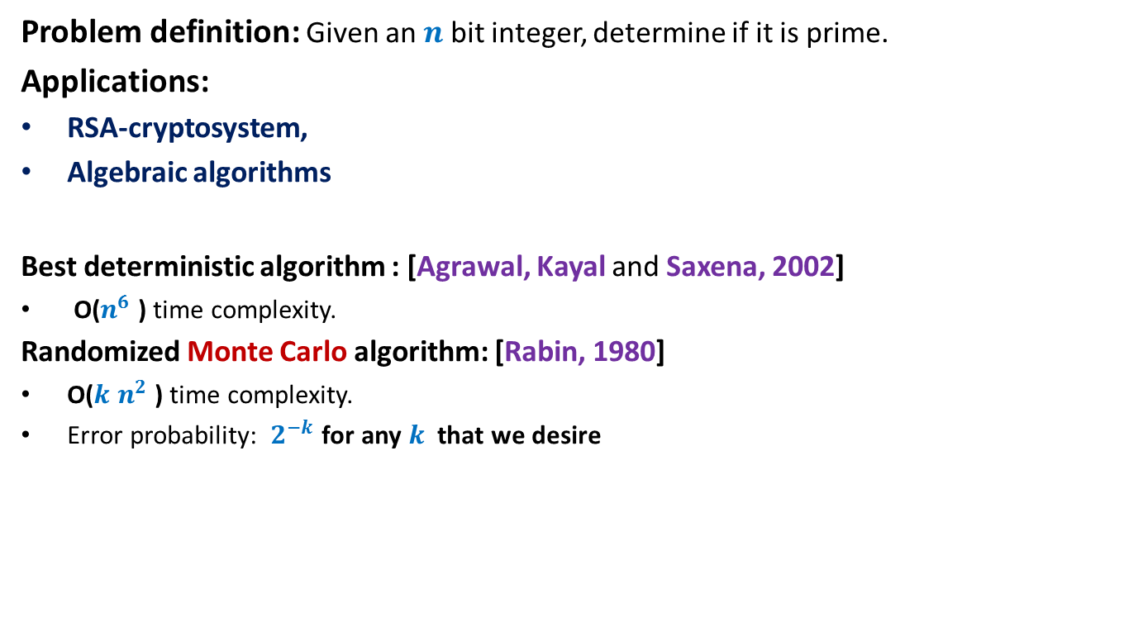
Example 5: Primality Testing
Problem definition: Given an $n$ bit integer, determine if it is prime.
Applications:
RSA-cryptosystem,
Algebraic algorithms
Best deterministic algorithm : [Agrawal, Kayal and Saxena, 2002]
O($n^{6}$ ) time complexity.
Randomized Monte Carlo algorithm: [Rabin, 1980]
O($k$ $n^{2}$ ) time complexity.
Error probability: $2^{−k}$ for any $k$ that we desire
For $k$= $50$, this probability is ${10}^{−15}$

Slide 37
Course Structure

Slide 38
Prerequisites for the course
Elementary knowledge of probability
Formal analysis
Formal proof of correctness
Basic algorithm paradigms
Good knowledge of algorithms
Ability to work very hard
Commitment to attend all classes
unless you have any genuine personal/medical problem

Slide 39
Marks Breakup
Assignments | 25%
Quizzes (announced) | 20%
Project (involves programming also) | 10%
Mid-semester exam | 20%
End-semester exam | 25%
Project:
Optional (To be done in groups of 2)
Assignments:
All theoretical.
To be done in groups of 2.
Passing criteria:
At least 25% marks in the exams (Quizzes, Mid-semester exam, End-semester exam).

Slide 40
Contact Details
Office: 307, Department of CSE
Office Hours:
fix appointment by email (preferably one day in advance).
Course website will be maintained at moodle.cse.iitk.ac.in
Entire course material (including all lecture slides) will be available on this website.

Slide 41
(Optional) Extra class
Time and date: 05:00 pm on 1st August
Venue: RM101.
Agenda:
Revising fundamentals of probability theory from perspective of this course.

Slide 45
Fun with probability

Slide 46
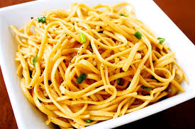
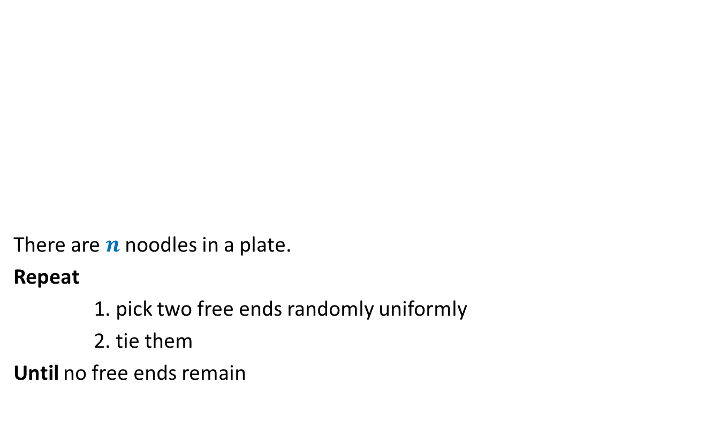
Noodle problem
There are $n$ noodles in a plate.
Repeat
1. pick two free ends randomly uniformly
2. tie them
Until no free ends remain
What is the average number of loops at the end ?

